Slide 1
Introduction to Computers and Java
Chapter 1

Slide 2
Objectives
Overview of computer hardware and software
Introduce program design and object-oriented programming
Overview of the Java programming language
(Optional) introduce applets and graphics basics

Slide 3
Outline
Computer Basics
Designing Programs
A Sip of Java
Graphics Supplement

Slide 4
Computer Basics: Outline
Hardware and Memory
Programs
Programming Languages and Compilers
Java Byte-Code
Graphics Supplement

Slide 5
Hardware and Software
Computer systems consist of hardware and software.
  Hardware includes the tangible parts of computer systems.
  Software includes programs - sets of instructions for the computer to follow.
Familiarity with hardware basics helps us understand software.

Slide 6
Hardware and Memory
Most modern computers have similar components including
  Input devices (keyboard, mouse, etc.)
  Output devices (display screen, printer, etc.)
  A processor
  Two kinds of memory (main memory and auxiliary memory).

Slide 7
The Processor
Also called the CPU (central processing unit) or the chip (e.g. Pentium processor)
The processor processes a program’s instructions.
It can process only very simple instructions.
The power of computing comes from speed and program intricacy.

Slide 8
Memory
Memory holds
  programs
  data for the computer to process
  the results of intermediate processing.
Two kinds of memory
  main memory
  auxiliary memory

Slide 9
Main memory
Working memory used to store
  The current program
  The data the program is using
  The results of intermediate calculations
Usually measured in megabytes (e.g. 8 gigabytes of RAM)
  RAM is short for random access memory
  A byte is a quantity of memory

Slide 10
Auxiliary Memory
Also called secondary memory
Disk drives, CDs, DVDs, flash drives, etc.
More or less permanent (nonvolatile)
Usually measured in gigabytes (e.g. 50 gigabyte hard drive)

Slide 11
Bits, Bytes, and Addresses
A bit is a digit with a value of either 0 or 1.
A byte consists of 8 bits.
Each byte in main memory resides at a numbered location called its address.

Slide 12
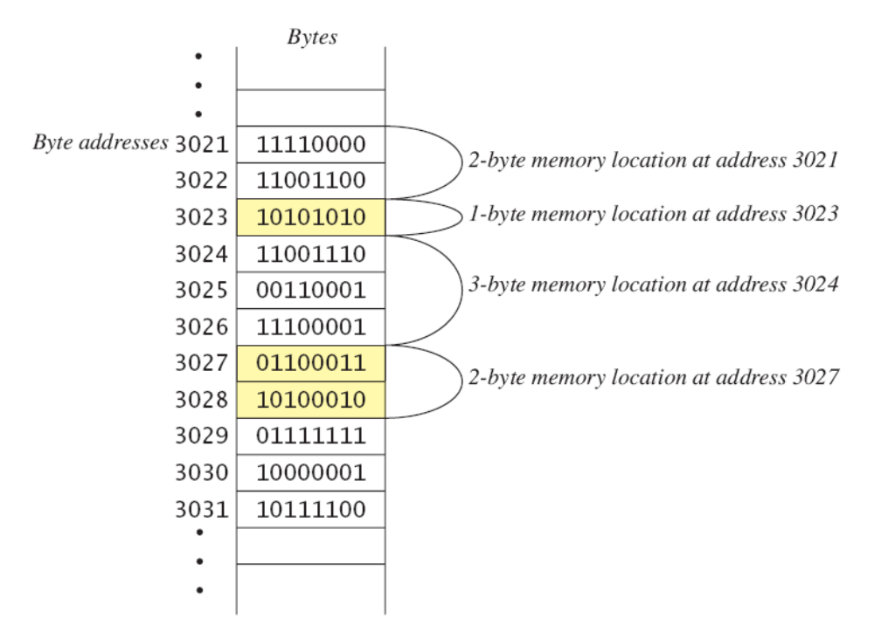
Main Memory
Figure 1.1

Slide 13
Storing Data
Data of all kinds (numbers, letters, strings of characters, audio, video, even programs) are encoded and stored using 1s and 0s.
When more than a single byte is needed, several adjacent bytes are used.
  The address of the first byte is the address of the unit of bytes.

Slide 14
Files
Large groups of bytes in auxiliary memory are called files.
Files have names.
Files are organized into groups called directories or folders.
Java programs are stored in files.
Programs files are copied from auxiliary memory to main memory in order to be run.

Slide 15
0s and 1s
Machines with only 2 stable states are easy to make, but programming using only 0s and 1s is difficult.
Fortunately, the conversion of numbers, letters, strings of characters, audio, video, and programs is done automatically.

Slide 16
Programs
A program is a set of instructions for a computer to follow.
We use programs almost daily (email, word processors, video games, bank ATMs, etc.).
Following the instructions is called running or executing the program.

Slide 17
Input and Output
Normally, a computer receives two kinds of input:
  The program
  The data needed by the program.
The output is the result(s) produced by following the instructions in the program.

Slide 18
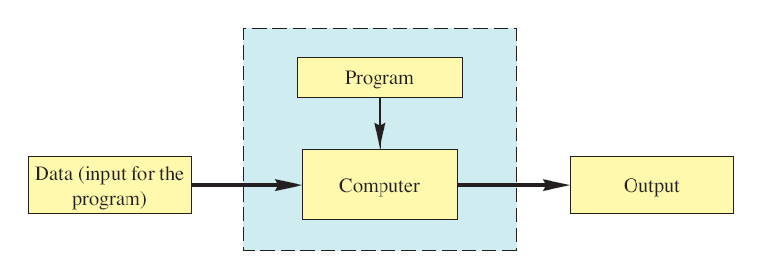
Running a Program
Figure 1.2
Sometimes the computer and the program are considered to be one unit.
  Programmers typically find this view to be more convenient.

Slide 19
The Operating System
The operating system is a supervisory program that oversees the operation of the computer.
The operating system retrieves and starts program for you.
Well-known operating systems including: Microsoft Windows, Apple’s Mac OS, Linux, and UNIX.

Slide 20
Programming Languages
High-level languages are relatively easy to use
  Java, C#, C++, Visual Basic, Python, Ruby.
Unfortunately, computer hardware does not understand high-level languages.
  Therefore, a high-level language program must be translated into a low-level language.

Slide 21
Compilers
A compiler translates a program from a high-level language to a low-level language the computer can run.
You compile a program by running the compiler on the high-level-language version of the program called the source program.
Compilers produce machine- or assembly-language programs called object programs.

Slide 22
Compilers
Most high-level languages need a different compiler for each type of computer and for each operating system.
Most compilers are very large programs that are expensive to produce.

Slide 23
Java Byte-Code
The Java compiler does not translate a Java program into assembly language or machine language for a particular computer.
Instead, it translates a Java program into byte-code.
  Byte-code is the machine language for a hypothetical computer (or interpreter) called the Java Virtual Machine.

Slide 24
Java Byte-Code
A byte-code program is easy to translate into machine language for any particular computer.
A program called an interpreter translates each byte-code instruction, executing the resulting machine-language instructions on the particular computer before translating the next byte-code instruction.
Most Java programs today are executed using a Just-In-Time or JIT compiler in which byte-code is compiled as needed and stored for later reuse without needing to be re-compiled.

Slide 25
Compiling, Interpreting, Running
Use the compiler to translate the Java program into byte-code (done using the javac command).
Use the Java virtual machine for your computer to translate each byte-code instruction into machine language and to run the resulting machine-language instructions (done using the java command).

Slide 26
Portability
After compiling a Java program into byte-code, that byte-code can be used on any computer with a byte-code interpreter and without a need to recompile.
Byte-code can be sent over the Internet and used anywhere in the world.
This makes Java suitable for Internet applications.

Slide 27
Class Loader
A Java program typically consists of several pieces called classes.
Each class may have a separate author and each is compiled (translated into byte-code) separately.
A class loader (called a linker in other programming languages) automatically connects the classes together.

Slide 28
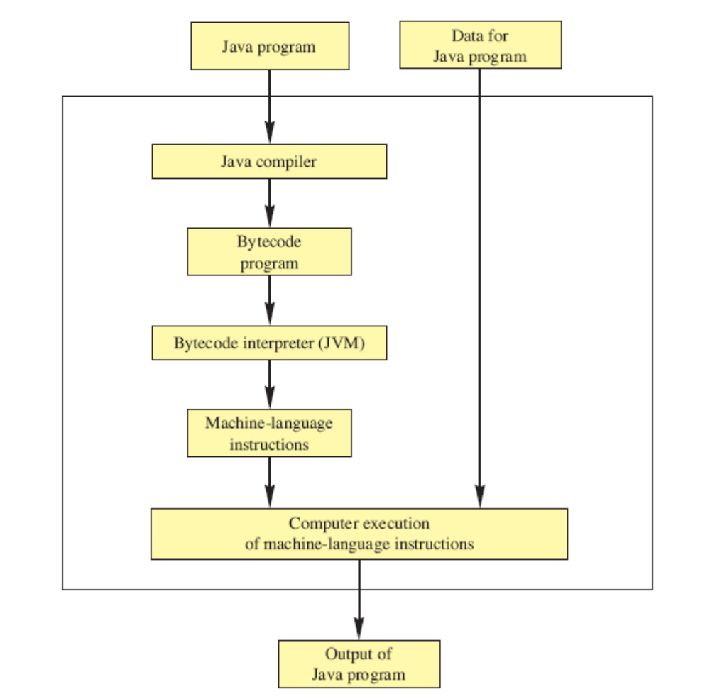
Compiling and Running a Program
Figure 1.3

Slide 29
A Sip of Java: Outline
History of the Java Language
Applications and Applets
A First Java Application Program
Writing, Compiling, and Running a Java Program

Slide 30
History of Java
In 1991, James Gosling and Sun Microsystems began designing a language for home appliances (toasters, TVs, etc.).
  Challenging, because home appliances are controlled by many different chips (processors)
  Programs were translated first into an intermediate language common to all appliance processors.

Slide 31
History of Java
  Then the intermediate language was translated into the machine language for a particular appliance’s processor.
  Appliance manufacturers weren’t impressed.
In 1994, Gosling realized that his language would be ideal for a Web browser that could run programs over the Internet.
  Sun produced the browser known today as HotJava.

Slide 32
Applications and Applets
Two kinds of java programs: applications and applets
Applications
  Regular programs
  Meant to be run on your computer
Applets
  Little applications
  Meant to be sent to another location on the internet and run there

Slide 33
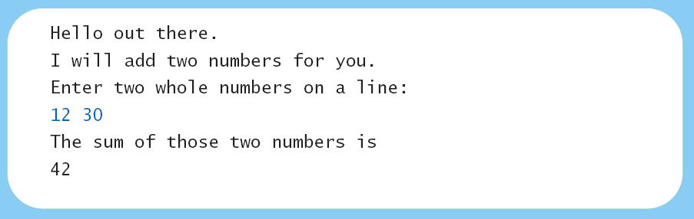
A First Java Application
View sample program Listing 1.1
  class FirstProgram
Sample
screen output

Slide 34
Some Terminology
The person who writes a program is called the programmer.
The person who interacts with the program is called the user.
A package is a library of classes that have been defined already.
  import java.util.Scanner;

Slide 35
Some Terminology
The item(s) inside parentheses are called argument(s) and provide the information needed by methods.
A variable is something that can store data.
An instruction to the computer is called a statement; it ends with a semicolon.
The grammar rules for a programming language are called the syntax of the language.

Slide 36
Printing to the Screen
System.out.println (“Whatever you want to print”);
System.out is an object for sending output to the screen.
println is a method to print whatever is in parentheses to the screen.

Slide 37
Printing to the Screen
The object performs an action when you invoke or call one of its methods
objectName.methodName(argumentsTheMethodNeeds);

Slide 38
Compiling a Java Program or Class
A Java program consists of one or more classes, which must be compiled before running the program.
You need not compile classes that accompany Java (e.g. System and Scanner).
Each class should be in a separate file.
The name of the file should be the same as the name of the class.

Slide 39
Compiling and Running
Use an IDE (integrated development environment) which combines a text editor with commands for compiling and running Java programs.
When a Java program is compiled, the byte-code version of the program has the same name, but the ending is changed from .java to .class.

Slide 40
Compiling and Running
A Java program can involve any number of classes.
The class to run will contain the words
public static void main(String[] args)
  somewhere in the file

Slide 41
Programming Basics: Outline
Object-Oriented Programming
Algorithms
Testing and Debugging
Software Reuse

Slide 42
Programming
Programming is a creative process.
Programming can be learned by discovering the techniques used by experienced programmers.
These techniques are applicable to almost every programming language, including Java.

Slide 43
Object-Oriented Programming
Our world consists of objects (people, trees, cars, cities, airline reservations, etc.).
Objects can perform actions which affect themselves and other objects in the world.
Object-oriented programming (OOP) treats a program as a collection of objects that interact by means of actions.

Slide 44
OOP Terminology
Objects, appropriately, are called objects.
Actions are called methods.
Objects of the same kind have the same type and belong to the same class.
  Objects within a class have a common set of methods and the same kinds of data
  but each object can have it’s own data values.

Slide 45
OOP Design Principles
OOP adheres to three primary design principles:
  Encapsulation
  Polymorphism
  Inheritance

Slide 46
Introduction to Encapsulation
The data and methods associated with any particular class are encapsulated (“put together in a capsule”), but only part of the contents is made accessible.
  Encapsulation provides a means of using the class, but it omits the details of how the class works.
  Encapsulation often is called information hiding.

Slide 47
Accessibility Example
An automobile consists of several parts and pieces and is capable of doing many useful things.
  Awareness of the accelerator pedal, the brake pedal, and the steering wheel is important to the driver.
  Awareness of the fuel injectors, the automatic braking control system, and the power steering pump is not important to the driver.

Slide 48
Introduction to Polymorphism
From the Greek meaning “many forms”
The same program instruction adapts to mean different things in different contexts.
  A method name, used as an instruction, produces results that depend on the class of the object that used the method.
  Everyday analogy: “take time to recreate” causes different people to do different activities
More about polymorphism in Chapter 8

Slide 49
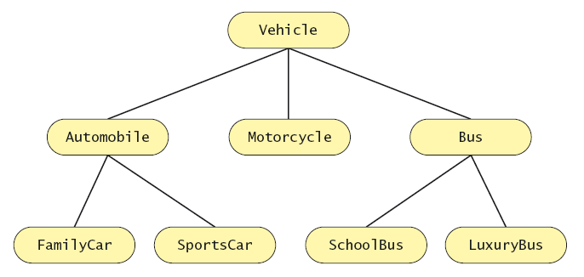
Introduction to Inheritance
Figure 1.4

Slide 50
Introduction to Inheritance
Classes can be organized using inheritance.
A class at lower levels inherits all the characteristics of classes above it in the hierarchy.
At each level, classifications become more specialized by adding other characteristics.
Higher classes are more inclusive; lower classes are less inclusive.

Slide 51
Inheritance in Java
Used to organize classes
“Inherited” characteristics do not need to be repeated.
New characteristics are added.
More about inheritance in chapter 8

Slide 52
Algorithms
By designing methods, programmers provide actions for objects to perform.
An algorithm describes a means of performing an action.
Once an algorithm is defined, expressing it in Java (or in another programming language) usually is easy.

Slide 53
Algorithms
An algorithm is a set of instructions for solving a problem.
An algorithm must be expressed completely and precisely.
Algorithms usually are expressed in English or in pseudocode.

Slide 54
Example: Total Cost of All Items
Write the number 0 on the whiteboard.
For each item on the list
  Add the cost of the item to the number on the whiteboard
  Replace the number on the whiteboard with the result of this addition.
Announce that the answer is the number written on the whiteboard.

Slide 55
Reusable Components
Most programs are created by combining components that exist already.
Reusing components saves time and money.
Reused components are likely to be better developed, and more reliable.
New components should designed to be reusable by other applications.

Slide 56
Testing and Debugging
Eliminate errors by avoiding them in the first place.
  Carefully design classes, algorithms and methods.
  Carefully code everything into Java.
Test your program with appropriate test cases (some where the answer is known), discover and fix any errors, then retest.

Slide 57
Errors
An error in a program is called a bug.
Eliminating errors is called debugging.
Three kinds or errors
  Syntax errors
  Runtime errors
  Logic errors

Slide 58
Syntax Errors
Grammatical mistakes in a program
  The grammatical rules for writing a program are very strict
The compiler catches syntax errors and prints an error message.
Example: using a period where a program expects a comma

Slide 59
Runtime Errors
Errors that are detected when your program is running, but not during compilation
When the computer detects an error, it terminates the program and prints an error message.
Example: attempting to divide by 0

Slide 60
Logic Errors
Errors that are not detected during compilation or while running, but which cause the program to produce incorrect results
Example: an attempt to calculate a Fahrenheit temperature from a Celsius temperature by multiplying by 9/5 and adding 23 instead of 32

Slide 61
Software Reuse
Programs not usually created entirely from scratch
Most contain components which already exist
Reusable classes are used
  Design class objects which are general
  Java provides many classes
  Note documentation on following slide

Slide 62
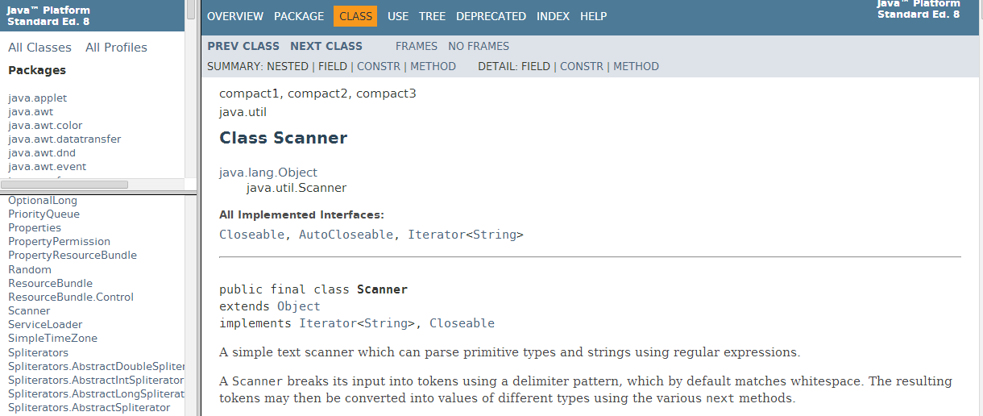
Software Reuse
Description of class Scanner
Package names
Class names

Slide 63
Graphics Supplement: Outline
Objects and Methods
A Sample Graphics Applet
Drawing Ovals and Circles
Size and Position of Figures
Drawing Arcs
Running and Closing an Applet

Slide 64
Objects and Methods
Recall that a method is an action which can be performed by an object.
In this section, we’ll name our object canvas and we’ll use it to draw figures inside an applet display.

Slide 65
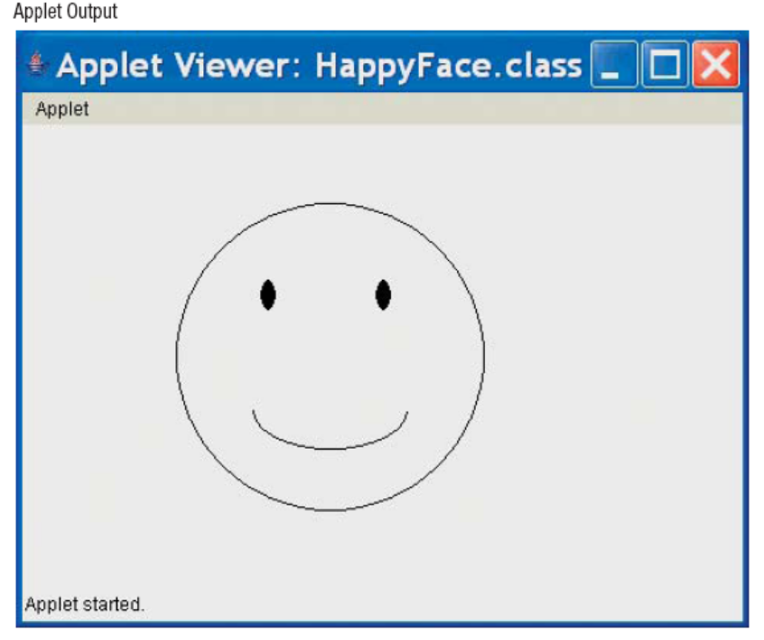
A Sample Graphics Applet
View sample program Listing 1.2
  class HappyFace (page 31)
Sample
screen output

Slide 66
A Sample Graphics Applet
The paint method specifies what is drawn in the applet.
The paint method is invoked automatically when the applet is run.

Slide 67
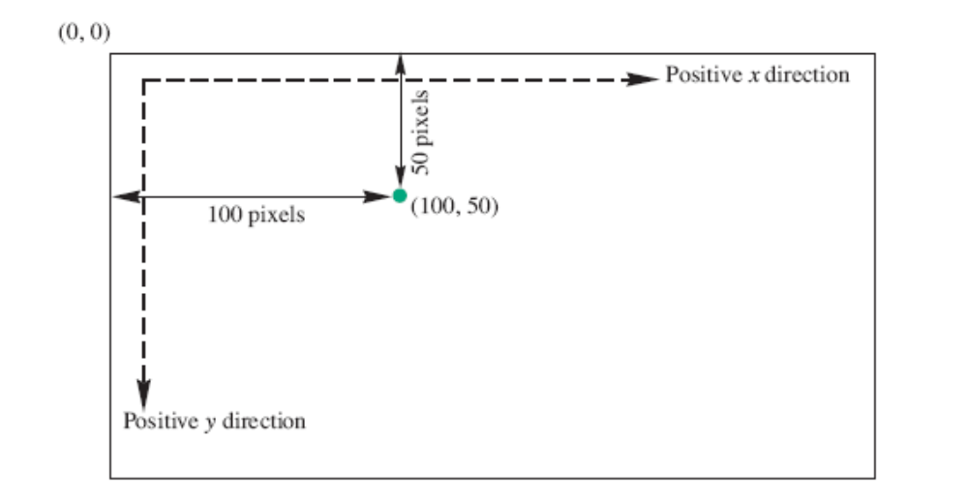
Screen Coordinate System
Figure 1.6

Slide 68
Screen Coordinate System
The x-coordinate the the number of pixels from the left.
The y-coordinate is the number of pixels from the top (not from the bottom).

Slide 69
Drawing Ovals and Circles
The drawOval method draws only the outline of the oval.
canvas.drawOval(100, 50, 90, 50);
The fillOval method draws a filled-in oval.
canvas.fillOval(100, 50, 90, 50);

Slide 70
Drawing Ovals and Circles
The drawOval and fillOval methods take four arguments.
  The first two arguments indicate the upper-left corner of an invisible rectangle around the oval.
  The last two arguments indicate the width and height of the oval.
A circle is just an oval whose height is the same as its width.

Slide 71
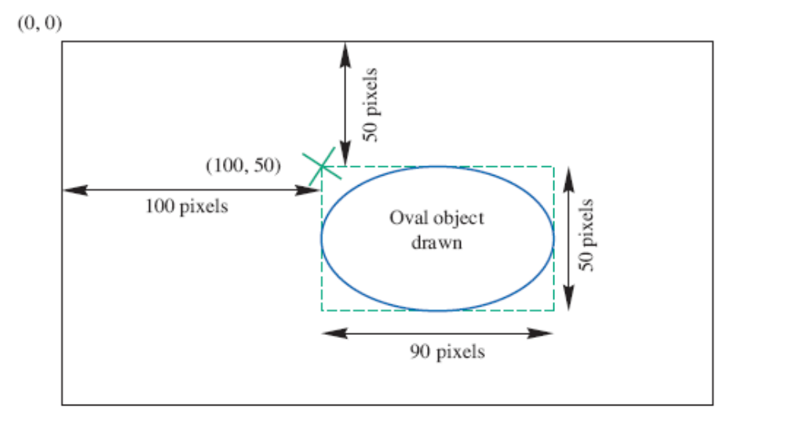
Drawing Ovals and Circles
Figure1.7 The Oval Drawn by canvas.drawOval(100, 50, 90, 50)

Slide 72
Size and Positions of Figures
Sizes and positions in a Java applet are given in pixels.
Think of the display surface for the applet as being a two-dimensional grid of individual pixels.

Slide 73
Drawing Arcs
The drawArc method draws an arc.
drawArc(100, 50, 200, 200, 180, 180);
The drawArc method takes six arguments.
  The first four arguments are the same as the four arguments needed by the drawOval method.
  The last two arguments indicate where the arc starts, and the number of degrees through which is sweeps.
  0 degrees is horizontal and to the right.

Slide 74
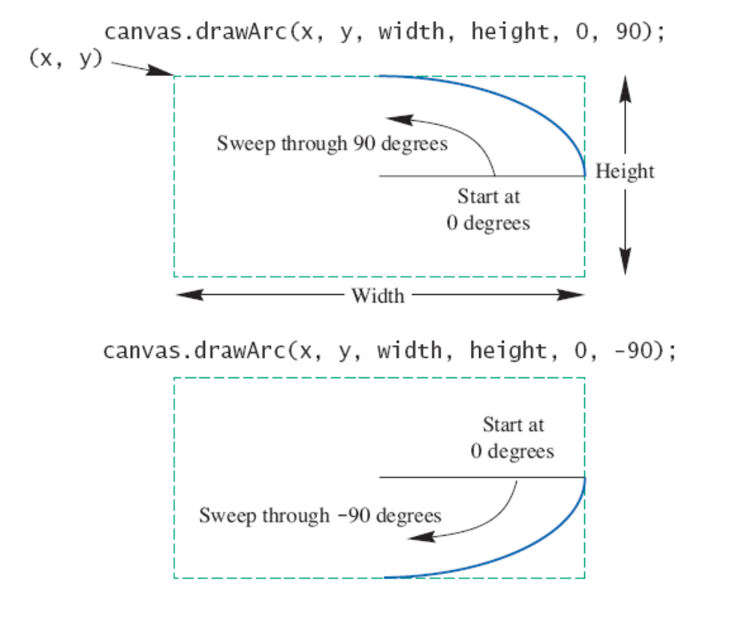
Specifying an Arc
Figure 1.8a

Slide 75
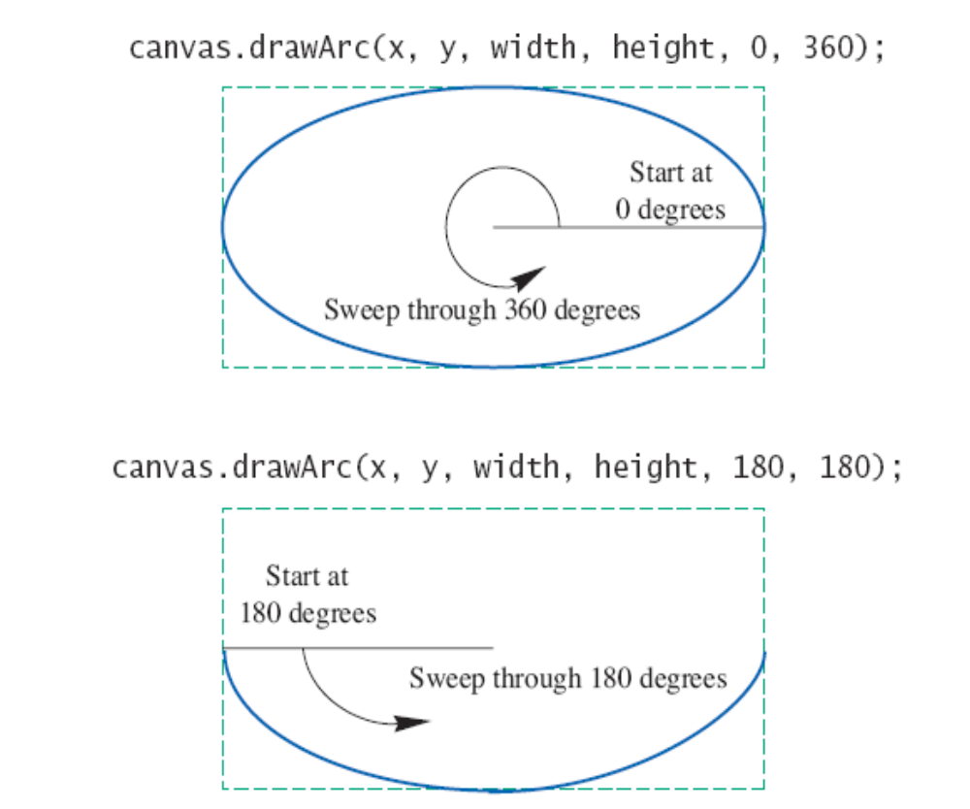
Specifying an Arc
Figure 1.8b

Slide 76
Running and Closing an Applet
There are two ways to run an applet:
  Embed the applet in a Web page and run it
  Use an applet viewer from the IDE.
There are two corresponding ways to end an applet:
  If you are running the applet from a web site, close the page or navigate away from the page
  If you are using an applet viewer, use the mouse to click the close-window button.

Slide 77
Summary
You have completed an overview of computer hardware and software.
You have been introduced to program design and object-oriented programming.
You have completed an overview of the Java programming language.
You have been introduced to applets and graphics basics.

